Slide 1
OBJECT ORIENTED PROGRAMMING LAB

Slide 2
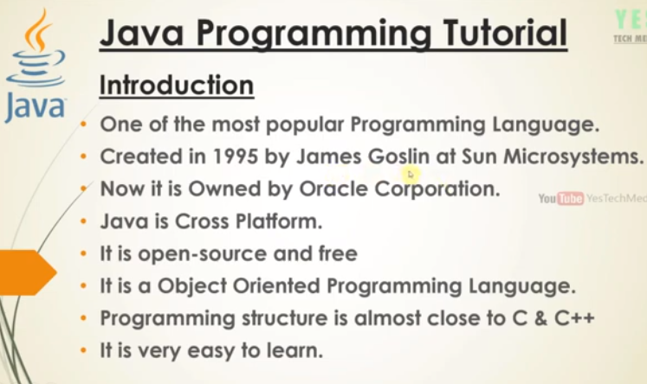

Slide 3
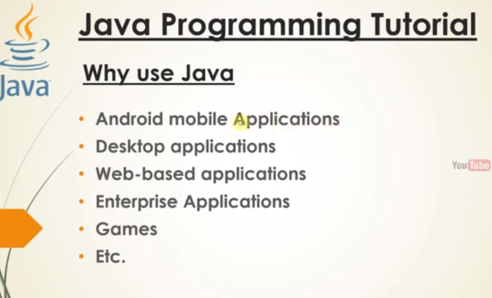

Slide 4
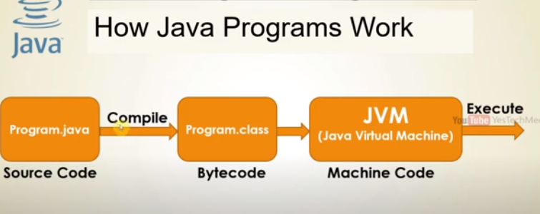

Slide 5
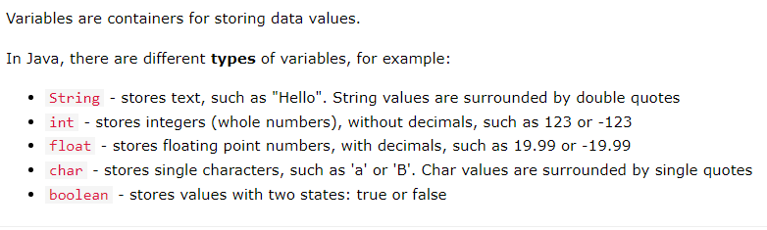
Java Variables

Slide 6
Declaring (Creating) Variables
Syntax
type variable_name=value;
Example
int var=10;

Slide 7
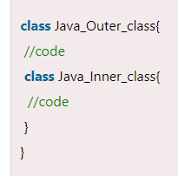
Java Inner Classes (Nested Classes)
Java inner class or nested class is a class that is declared inside the class or interface.
Nested classes represent a particular type of relationship that is it can access all the members (data members and methods) of the outer class, including private.

Slide 8
Syntax to create an object of the member inner class
OuterClass obj1=new OuterClass();
OuterClass.InnerClass obj2=obj1.new InnerClass();

Slide 9
Array of Objects in Java
Java allows us to store objects in an array.
In Java, the class is also a user-defined data type.
An array that conations class type elements are known as an array of objects.
It stores the reference variable of the object.

Slide 10
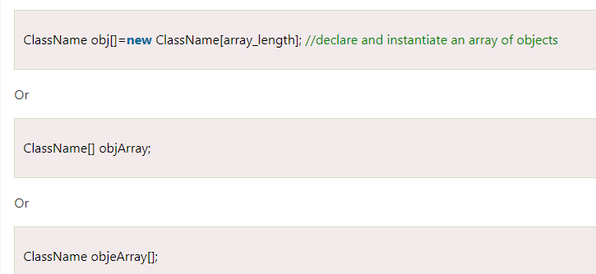
Creating an Array of Objects

Slide 11
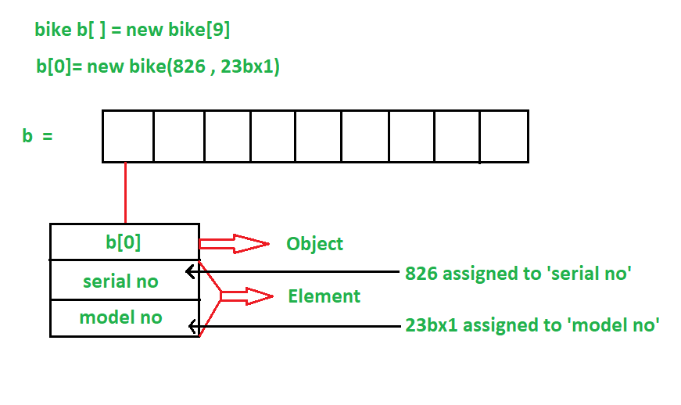
Create
The individual elements of the array of objects needs to be created using the new keyword.

Slide 12
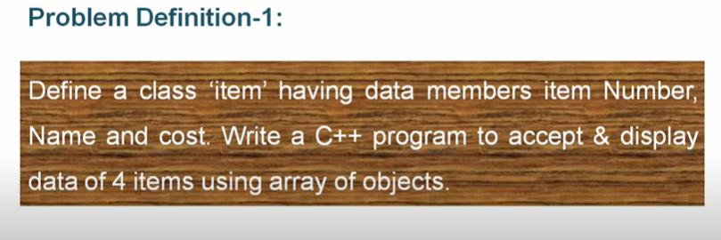
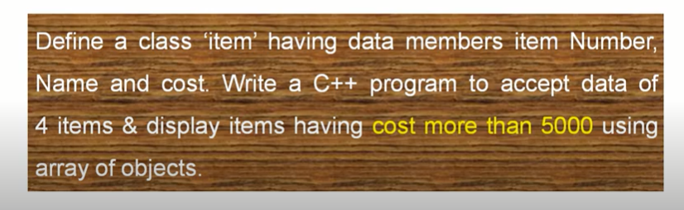
Lab question based on array of objects

Slide 13
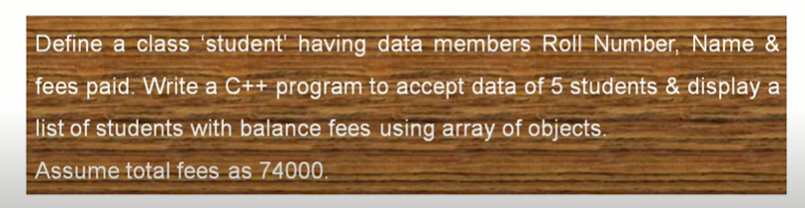
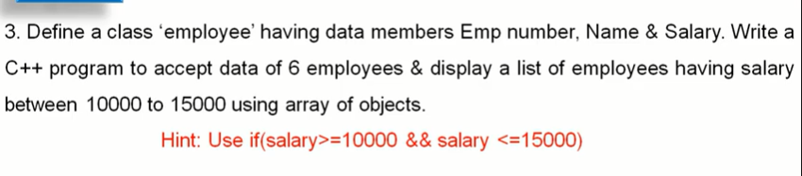

Slide 14
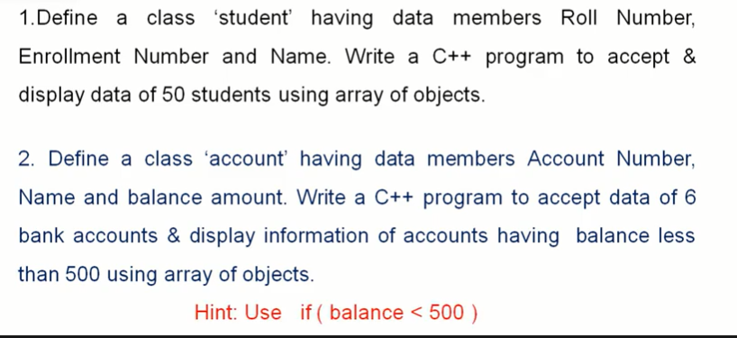

Slide 15
Method Overloading in Java
If a class has multiple methods having same name but different in parameters, it is known as Method Overloading
Advantage of method overloading
Method overloading increases the readability of the program.
Different ways to overload the method
There are two ways to overload the method in java
By changing number of arguments.
By changing the data type.

Slide 16
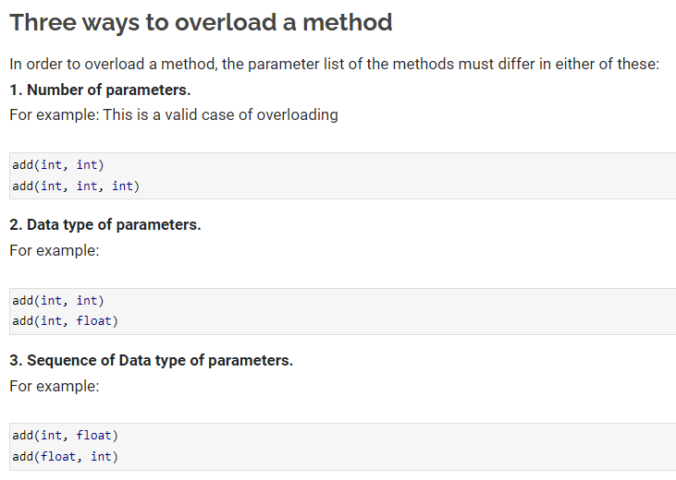

Slide 17
Inheritance
The process of deriving new class from the existing one is called inheritance
Passing the properties of one class to another
Then the old class is called base class or superclass or parent class and the new class is called derived class or sub class
The derived class inherits some or all properties of base class
Inheritance allows code reusability. This implies, it facilitates classes to reuse the existing code. The new class acquires those members of the old class that are already tested and debugged.
Note: all members of a class, except Private are inherited

Slide 18
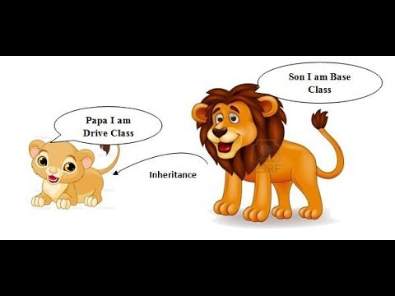

Slide 19
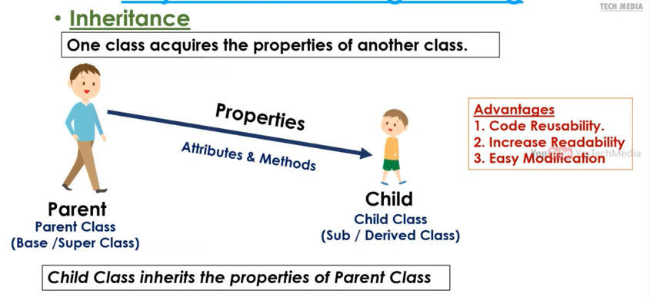

Slide 20
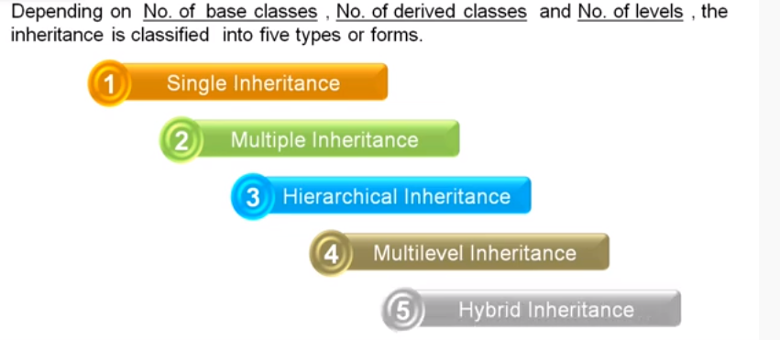
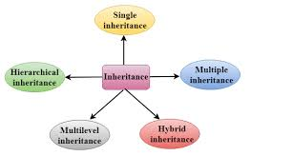
Types of Inheritance

Slide 21
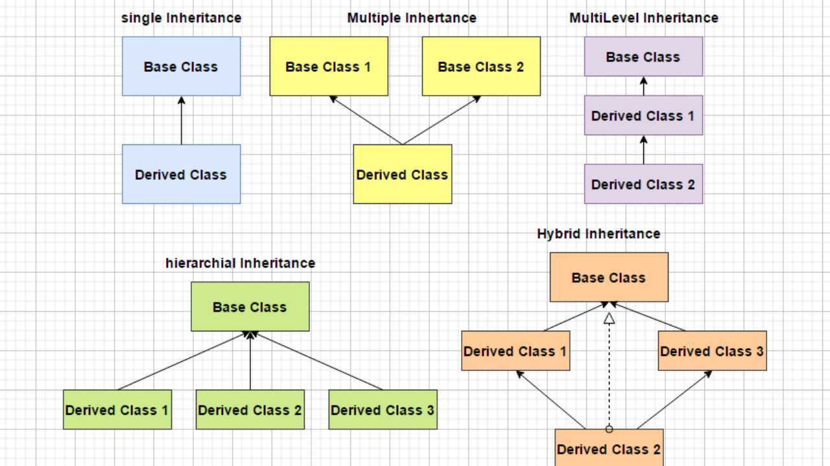
Types of Inheritance

Slide 22
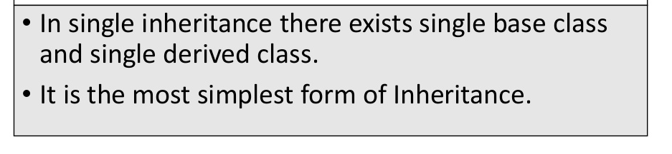
Single Inheritance
A
B

Slide 23
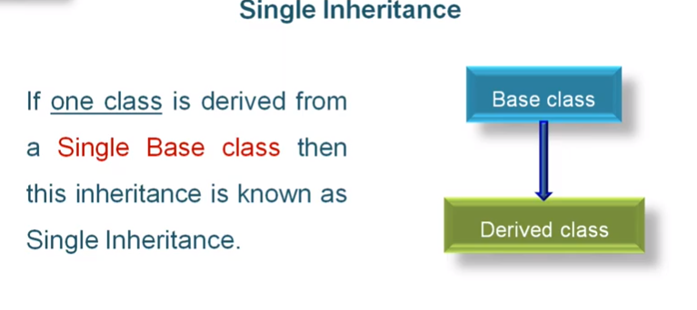
Single inheritance

Slide 24
1. Create a class ‘Employee’ with data members Empid, Name, Salary, Address and
constructors to initialize the data members. Create another class ‘Teacher’ that inherit the
properties of class employee and contain its own data members department, Subjects taught
and constructors to initialize these data members and also include display function to
display all the data members. Use array of objects to display details of N teachers.

Slide 25
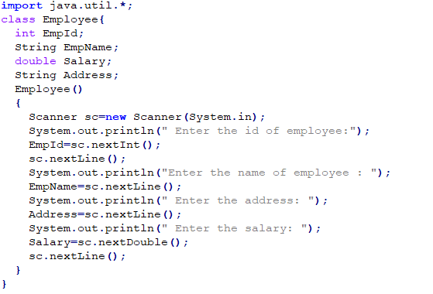

Slide 26
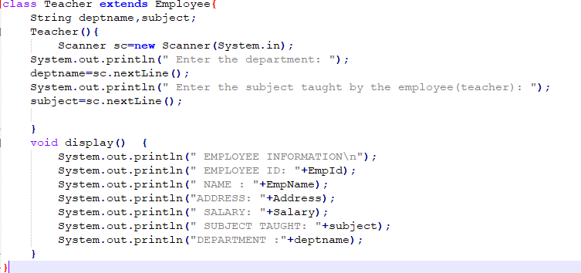

Slide 27
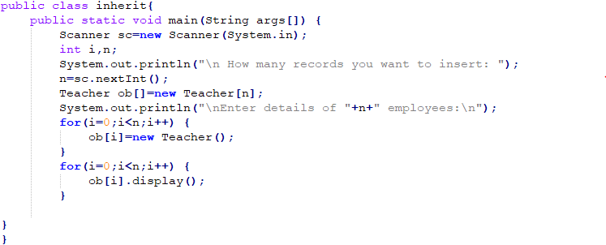

Slide 28
2. Create a class ‘Person’ with data members Name, Gender, Address, Age and a constructor
to initialize the data members and another class ‘Employee’ that inherits the properties of
class Person and also contains its own data members like Empid, Company_name,
Qualification, Salary and its own constructor. Create another class ‘Teacher’ that inherits
the properties of class Employee and contains its own data members like Subject,
Department, Teacherid and also contain constructors and methods to display the data
members. Use array of objects to display details of N teachers.

Slide 29
3.Wap using overloaded function to find the largest of
a)two numbers
b)three numbers
4.Wap using overloaded function to perform different types of sum such as
a)sum of two numbers
b)sum of digits of a number
c)sum of 2 strings
5.Overload a function ‘average’ to find average of two integers, two double values and three float values.
Function Overloading

Slide 30
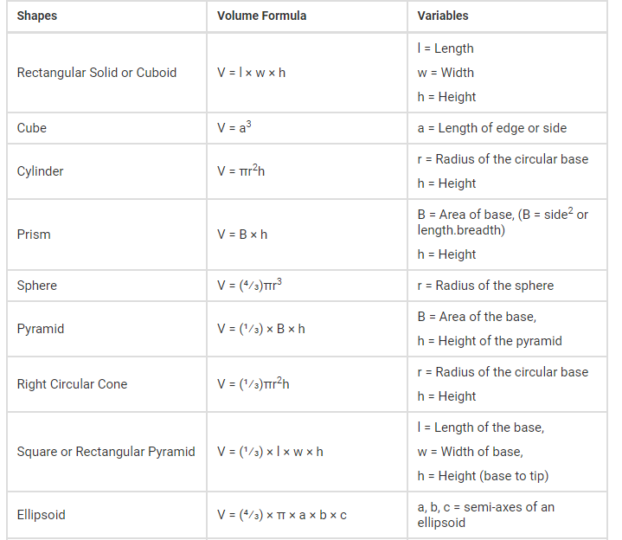
6. Volume of shapes.

Slide 31
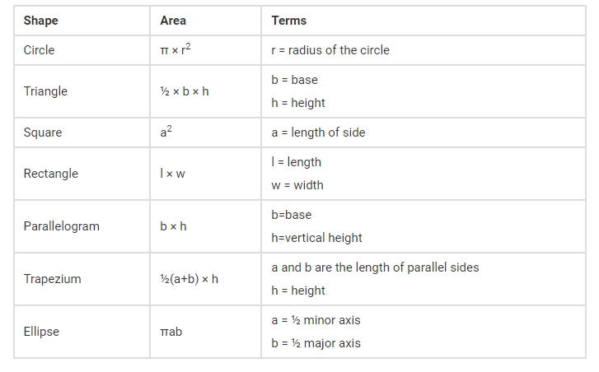
7.Area of different shapes using overloaded functions

Slide 32
Single inheritance
8. Wap to define a class ‘student’ having data members rollno, name. Derive a class ‘marks’ from ‘student’ having data members m1, m2, m3, total and percentage. Accept and display data of one student.
9. Wap to define a class ‘employee’ having data members emp_id, emp_name and emp_designation. Derive a class ‘salary’ from ‘employee’ having data members basic, HRA, DA, gross_salary. Accept and display data of one employee.
DA=basic*35/100
HRA=basic*15/100
GS=basic+DA+HRA
10. Declare a class ‘box’ having data members length, width and height. Derive a class ‘cupboard’ from ‘box’ having data members no of shelves. Wap to accept and display this data for one cupboard object.
11. Wap to define a class ‘employee’ having data members emp_id and emp_name. Derive a class ‘worker’ from ‘employee’ having data members daily_wages. Accept and display data of one worker.

Slide 33
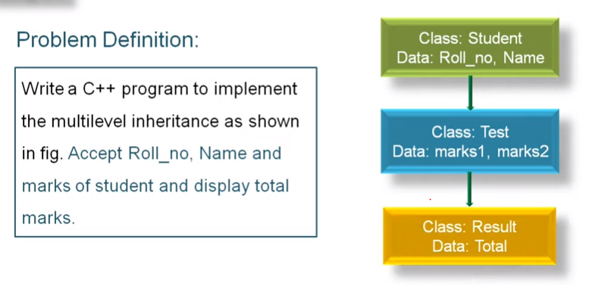
Multilevel inheritance
12.Wap to find the total marks obtained and percentage scored by a student.

